Slide 1
Socket Programming
Dr. Geetha V
Assistant Professor
Dept of IT,
NITK Surathkal

Slide 2
Socket Programming
What is a socket?
Using sockets
  Types (Protocols)
  Associated functions
  Styles
  We will look at using sockets in C

Slide 3
What is a socket?
An interface between application and network
  The application creates a socket
  The socket type dictates the style of communication
    reliable vs. best effort
    connection-oriented vs. connectionless
Once configured the application can
  pass data to the socket for network transmission
  receive data from the socket (transmitted through the network by some other host)

Slide 4
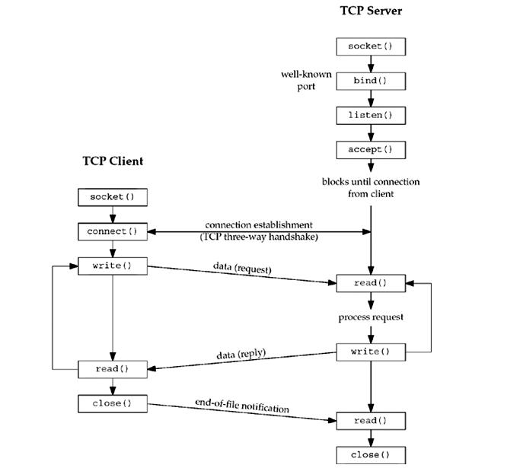

Socket – client server functions

Slide 5
Server - Client
//fileclient.cc
#include<stdio.h>
#include<unistd.h>
#include<string.h>
#include<sys/socket.h>
#include<netinet/in.h>
#include<sys/types.h>
#define SERV_PORT 5576
main(int argc,char **argv)
{
int i,j;
ssize_t n;
char filename[80],recvline[80];
struct sockaddr_in servaddr;
int sockfd;
//fileserver.cc
#include<stdio.h>
#include<unistd.h>
#include<string.h>
#include<sys/socket.h>
#include<netinet/in.h>
#include<sys/types.h>
#define SERV_PORT 5576
main(int argc,char **argv) {
int i,j;
ssize_t n;
FILE *fp;
char s[80],f[80];
struct sockaddr_in servaddr,cliaddr;
int listenfd,connfd,clilen;

Slide 6
Socket header files
#include<sys/socket.h>
Defines socket prototypes, macros, variables, and the following structures: sockaddr, msghdr, linger
#include<netinet/in.h>
Defines prototypes, macros, variables, and the sockaddr_in structure to use with Internet domain sockets.
File:NETINET Member:IN

Slide 7
Socket header files
#include<sys/types.h>
Defines various data types. Also includes prototypes, macros, variables, and structures that are associated with the select() function. You must include this file in all socket applications.
File:SYS Member:TYPES
#include<unistd.h>
Contains macros and structures that are defined by the integrated file system. Needed when the system uses the read() and write() system functions. File:H Member:UNISTD

Slide 8
The struct sockaddr
The generic:
defined in sys/socket.h
  struct sockaddr {
    u_short sa_family;
    char sa_data[14];
  };
  sa_family
    specifies which address family is being used
    determines how the remaining 14 bytes are used
The Internet-specific:
Defined in netinet/in.h
  struct sockaddr_in {
    short sin_family;
    u_short sin_port;
    struct in_addr sin_addr;
    char sin_zero[8];
  };
  sin_family = AF_INET
  sin_port: port # (0-65535)
  sin_addr: IP-address
  sin_zero: unused

Slide 9
Server - Client
//fileclient.cc
#include<stdio.h>
#include<unistd.h>
#include<string.h>
#include<sys/socket.h>
#include<netinet/in.h>
#include<sys/types.h>
#define SERV_PORT 5576
main(int argc,char **argv)
{
int i,j;
ssize_t n;
char filename[80],recvline[80];
struct sockaddr_in servaddr;
int sockfd;
//fileserver.cc
#include<stdio.h>
#include<unistd.h>
#include<string.h>
#include<sys/socket.h>
#include<netinet/in.h>
#include<sys/types.h>
#define SERV_PORT 5576
main(int argc,char **argv) {
int i,j;
ssize_t n;
FILE *fp;
char s[80],f[80];
struct sockaddr_in servaddr,cliaddr;
int listenfd,connfd,clilen;

Slide 10
Server - Client
listenfd=socket(
AF_INET,
SOCK_STREAM,0);
sockfd=socket(
AF_INET,
SOCK_STREAM,0);
int s = socket(domain, type, protocol);
  s: socket descriptor, an integer (like a file-handle)
  domain: integer, communication domain
    e.g., PF_INET (IPv4 protocol) – typically used
    e.g. AF_INET (Ipv4 – Internet Protocol)
  type: communication type
    SOCK_STREAM: reliable, 2-way, connection-based service
    SOCK_DGRAM: unreliable, connectionless,
  protocol: specifies protocol (see file /etc/protocols for a list of options) - usually set to 0

Slide 11
Server - Client
listenfd=socket(
AF_INET,
SOCK_STREAM,0);
sockfd=socket(
AF_INET,
SOCK_STREAM,0);
int s = socket(domain, type, protocol);
  s: socket descriptor, an integer (like a file-handle)
  domain: integer, communication domain
    e.g., PF_INET (Protocol Family – socket- IPv4 protocol)
    e.g. AF_INET (Address Family- sockaddr_in Ipv4 )
  type: communication type
    SOCK_STREAM: reliable, 2-way, connection-based service
    SOCK_DGRAM: unreliable, connectionless,
  protocol: specifies protocol (see file /etc/protocols for a list of options) - usually set to 0

Slide 12
Server
bzero(&servaddr,sizeof(servaddr));
//bzero(char* c, int n): 0’s n bytes starting at c
servaddr.sin_family=AF_INET;
servaddr.sin_port=htons(SERV_PORT);
bind(listenfd,(struct sockaddr *)&servaddr, sizeof(servaddr));
associates and (can exclusively) reserves a port for use by the socket
int status = bind(sockid, &addrport, size);
  status: error status, = -1 if bind failed
  sockid: integer, socket descriptor
  addrport: struct sockaddr, the (IP) address and port of the machine (address usually set to INADDR_ANY – chooses a local address)
  size: the size (in bytes) of the addrport structure

Slide 13
Server
listen(listenfd,1);
Called by passive participant
int status = listen(sock, queuelen);
  status: 0 if listening, -1 if error
  sock: integer, socket descriptor
  queuelen: integer, # of active participants that can “wait” for a connection
  listen is non-blocking: returns immediately

Slide 14
Client
bzero(&servaddr,sizeof(servaddr));
servaddr.sin_family=AF_INET;
servaddr.sin_port=htons(SERV_PORT);
inet_pton(AF_INET,argv[1],&servaddr.sin_addr);
connect(sockfd,(struct sockaddr*)&servaddr,sizeof(servaddr));
int status = connect(sock, &name, namelen);
  status: 0 if successful connect, -1 otherwise
  sock: integer, socket to be used in connection
  name: struct sockaddr: address of passive participant
  namelen: integer, sizeof(name)
connect is blocking

Slide 15
Client
bzero(&servaddr,sizeof(servaddr));
servaddr.sin_family=AF_INET;
servaddr.sin_port=htons(SERV_PORT);
inet_pton(AF_INET,argv[1],&servaddr.sin_addr);
connect(sockfd,(struct sockaddr*)&servaddr,sizeof(servaddr));
#include <netinet/in.h>
uint32_t htonl(uint32_t hostlong); Host to network long
uint16_t htons(uint16_t hostshort); Host to network Short
uint32_t ntohl(uint32_t netlong); Network to host long
uint16_t ntohs(uint16_t netshort); Network to host short
Host Byte-Ordering: the byte ordering used by a host (big or little) Intel: little endian. Motorola IBM –Big Endian
Network Byte-Ordering: the byte ordering used by the network – always big-endian

Slide 16
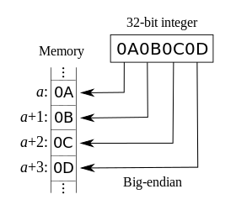
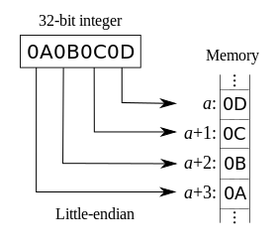
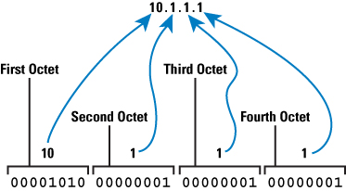
Little and Big Endian
1: Introduction

Slide 17
Client
bzero(&servaddr,sizeof(servaddr));
servaddr.sin_family=AF_INET;
servaddr.sin_port=htons(SERV_PORT);
inet_pton(AF_INET,argv[1],&servaddr.sin_addr);
connect(sockfd,(struct sockaddr*)&servaddr,sizeof(servaddr));
n=>network p=>presentation
const char *inet_ntop(int af, const void *src, char *dst, socklen_t size);
Network format to printable or dotted format
int inet_pton(int af, const char *src, void *dst); Dotted format of address to network format

Slide 18
Server
clilen=sizeof(cliaddr);
connfd=accept(listenfd,(struct sockaddr*)&cliaddr, &clilen);
printf("\n clinet connected");
int s = accept(sock, &name, &namelen);
  s: integer, the new socket (used for data-transfer)
  sock: integer, the orig. socket (being listened on)
  name: struct sockaddr, address of the active participant
  namelen: sizeof(name): value/result parameter
    must be set appropriately before call
    adjusted by OS upon return
  accept is blocking: waits for connection before returning

Slide 19
Server - Client
read(connfd,f,80);
fp=fopen(f,"r");
printf("\n name of the file: %s",f);
while(fgets(s,80,fp)!=NULL)
{
printf("%s",s);
write(connfd,s,sizeof(s));
}
close(listenfd);
fclose(fp); } //close main
printf("enter the file name");
scanf("%s",filename);
write(sockfd,filename,sizeof(
filename));
printf("\n data from server: \n");
while(read(sockfd,recvline,80)!=0)
{
fputs(recvline,stdout);
}
close(sockfd);
}
1: Introduction

Slide 20
Sending / Receiving Data
With a connection (SOCK_STREAM):
  int count = send(sock, &buf, len, flags);
    count: # bytes transmitted (-1 if error)
    buf: char[], buffer to be transmitted
    len: integer, length of buffer (in bytes) to transmit
    flags: integer, special options, usually just 0
  int count = recv(sock, &buf, len, flags);
    count: # bytes received (-1 if error)
    buf: void[], stores received bytes
    len: # bytes received
    flags: integer, special options, usually just 0
  Calls are blocking [returns only after data is sent (to socket buf) / received]

Slide 21
close
When finished using a socket, the socket should be closed:
status = close(s);
  status: 0 if successful, -1 if error
  s: the file descriptor (socket being closed)
Closing a socket
  closes a connection (for SOCK_STREAM)
  frees up the port used by the socket

Slide 22
Solution: Network Byte-Ordering
Defs:
  Host Byte-Ordering: the byte ordering used by a host (big or little)
  Network Byte-Ordering: the byte ordering used by the network – always big-endian
Any words sent through the network should be converted to Network Byte-Order prior to transmission (and back to Host Byte-Order once received)

Slide 23
Dealing with blocking calls
Many of the functions we saw block until a certain event
  accept: until a connection comes in
  connect: until the connection is established
  recv: until a packet (of data) is received
  send: until data is pushed into socket’s buffer
    Q: why not until received?
For simple programs, blocking is convenient
What about more complex programs?
  multiple connections
  simultaneous sends and receives
  simultaneously doing non-networking processing

Slide 24
Other useful functions
bzero(char* c, int n): 0’s n bytes starting at c
gethostname(char *name, int len): gets the name of the current host
gethostbyaddr(char *addr, int len, int type): converts IP hostname to structure containing long integer
inet_addr(const char *cp): converts dotted-decimal char-string to long integer
inet_ntoa(const struct in_addr in): converts long to dotted-decimal notation
Warning: check function assumptions about byte-ordering (host or network). Often, they assume parameters / return solutions in network byte-order

Slide 25
Server Program Client Program
Define Headers
Main() :
  Define variables
  Socket()
  Bind()
  Listen()
  accept()
  Read/write
  close
Define Headers
Main()
  Define variables
  Socket()
  Connect
  Write/read
  close

Slide 26
headers
//server
#include<stdio.h>
#include<unistd.h>
#include<string.h>
#include<sys/socket.h>
#include<netinet/in.h>
#include<sys/types.h>
#define SERV_PORT 5576
//client
#include<stdio.h>
#include<unistd.h>
#include<string.h>
#include<sys/socket.h>
#include<netinet/in.h>
#include<sys/types.h>
#define SERV_PORT 5576
1: Introduction

Slide 27
pgm
//server
main(int argc,char **argv)
{
int i,j;
ssize_t n;
FILE *fp;
char s[80],f[80];
struct sockaddr_in servaddr,cliaddr;
int listenfd,connfd,clilen;
//client
main(int argc,char **argv)
{
int i,j;
ssize_t n;
char filename[80],recvline[80];
struct sockaddr_in servaddr;
int sockfd;

Slide 28
pgm
//server
listenfd=socket(AF_INET,SOCK_STREAM,0);
bzero(&servaddr,sizeof(servaddr));
servaddr.sin_family=AF_INET;
servaddr.sin_port=htons(SERV_PORT);
bind(listenfd,(struct sockaddr *)&servaddr,sizeof(servaddr));
listen(listenfd,1);
//client
sockfd=socket(AF_INET,SOCK_STREAM,0);

Slide 29
pgm
//server
clilen=sizeof(cliaddr);
connfd=accept(listenfd,(struct sockaddr*)&cliaddr,&clilen);
//client
bzero(&servaddr,sizeof(servaddr));
servaddr.sin_family=AF_INET;
servaddr.sin_port=htons(SERV_PORT);
inet_pton(AF_INET,argv[1],&servaddr.sin_addr);
connect(sockfd,(struct sockaddr*)&servaddr,sizeof(servaddr));

Slide 30
Read/write
//server
printf("\n clinet connected");
read(connfd,f,80);
fp=fopen(f,"r");
printf("\n name of the file: %s",f);
while(fgets(s,80,fp)!=NULL)
{
printf("%s",s);
write(connfd,s,sizeof(s));
}
close(listenfd);
fclose(fp);
}
//client
printf("enter the file name");
scanf("%s",filename);
write(sockfd,filename,sizeof(filename));
printf("\n data from server: \n");
while(read(sockfd,recvline,80)!=0)
{
fputs(recvline,stdout);
}
close(sockfd);
}

